Slide 1
The 2013 VVV Reunion
Greenwood, Mississippi
July 18 - 20

Slide 2
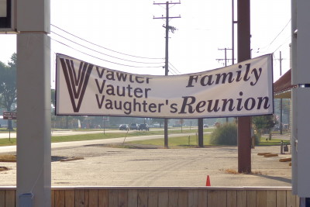

Slide 3
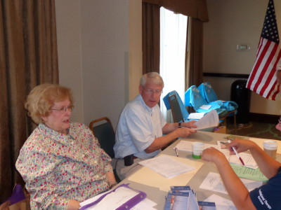
Faithful Norma Wicker helped
with registration again this year.
Host Roger Wicker is checking on the latest count.

Slide 4
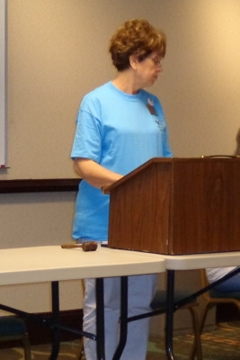
VVV President Connie Bugos
opened the meeting Friday morning.

Slide 5
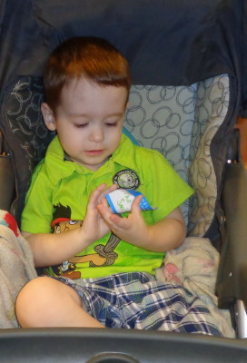
Ian Smith rang the traditional cowbell.

Slide 6
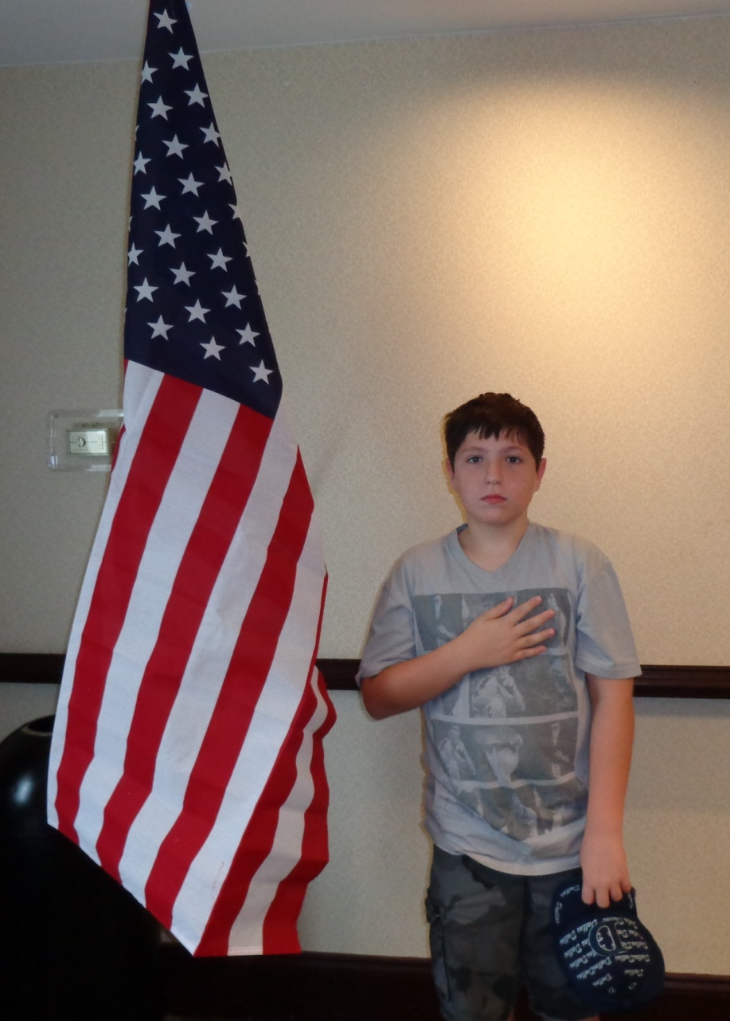
Luke Williams led the Pledge of Allegiance

Slide 7
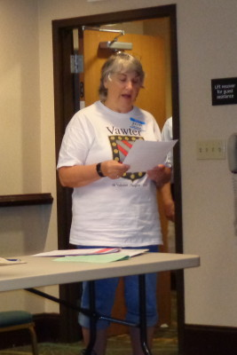
Rebecca Guinagh read the minutes
from the 2012 reunion.

Slide 8
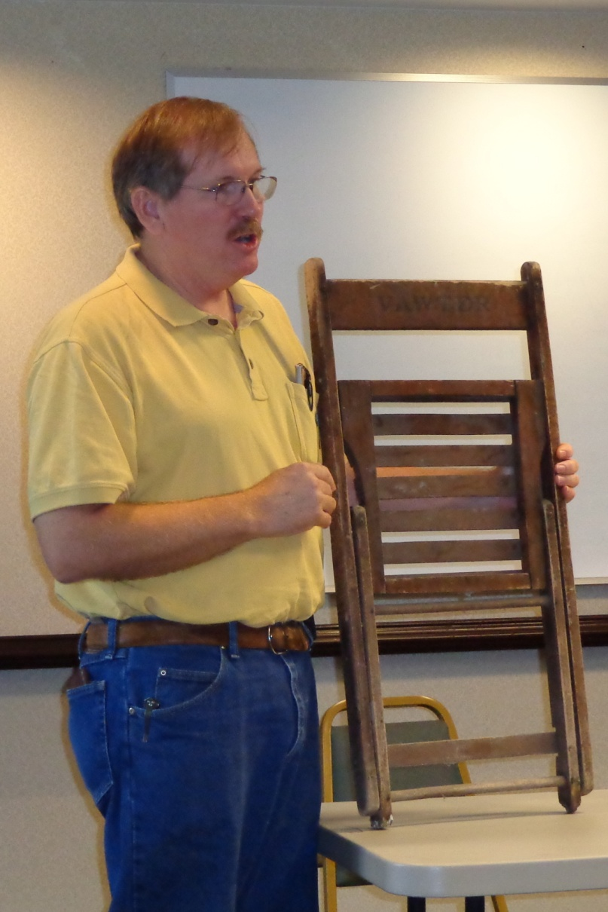
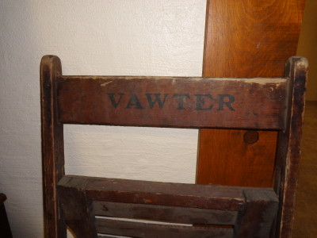
Jordan shows an antique chair
shipped to the VVV Association.
It has VAWTER stenciled on the
back. The man who sent it
(from Nebraska) owned it
for more than 30 years, but
does not know the history.
He Is not Vawter kin.

Slide 9
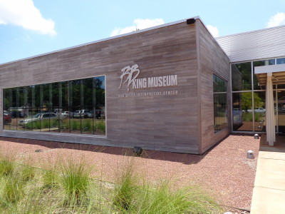
Friday morning, cousins traveled to Indianola
to visit the B. B. King museum.

Slide 10
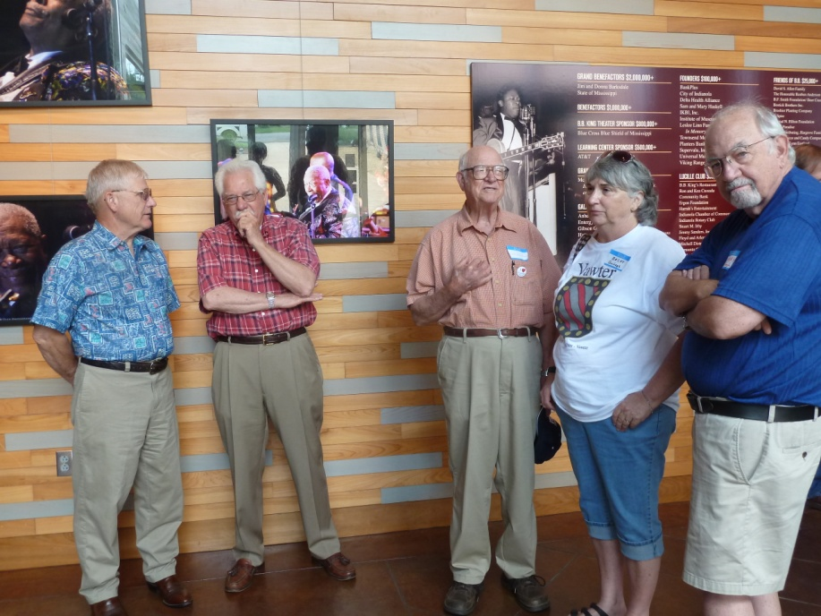
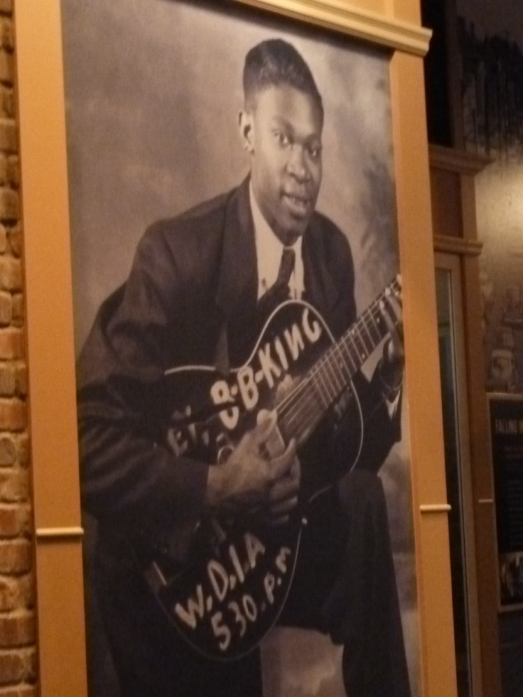
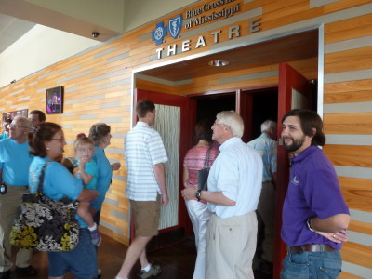

Slide 11
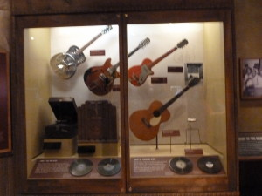
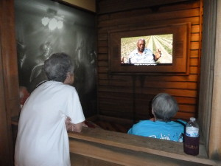
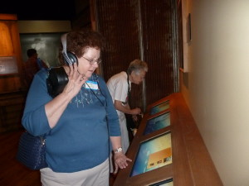
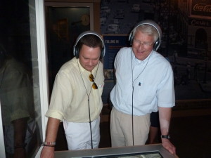

Slide 12
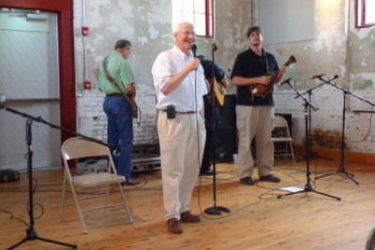
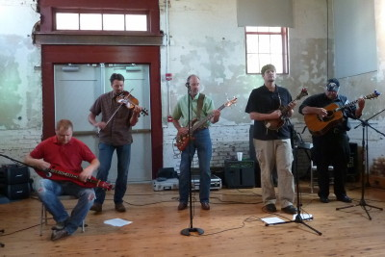
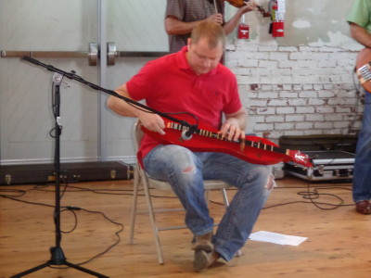
Host Roger Wicker introduces
THE BLUE GRASS APPEAL
For some toe-tapping music.
Below, Dueling Banjos,
on one dulcimer.

Slide 13
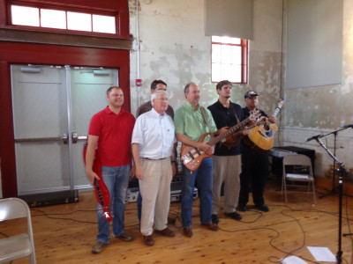
Roger Wicker with the band, The Blue Grass Appeal

Slide 14
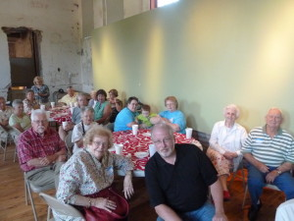
Ken Wicker, Dorothy Vawter, Jackie Smith, Ian Smith
Martha Hudson. On the right, Sybil and Harold Lansdale.
In front, Norma Wicker and Tom Wicker.

Slide 15
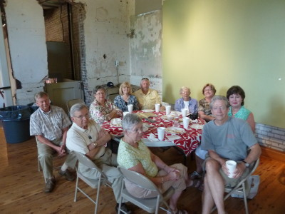
Palmer Triplett, Lera Triplett, Debby Wiley, Bob Wiley, Pearl Wiley, Ellen White,
Merrie Wiley. In front, John Bowlin, Linda Bowlin and Thomas Wiley

Slide 16
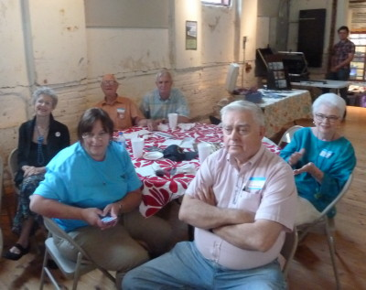
Ellen Cummings, Fred Wicker, George Wicker
In the front, Dorrie, Bill and Katie Burrow.

Slide 17
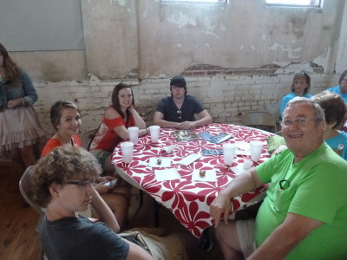
Paul Bugos (right) with Dylan and Tyler Bugos,
Michelle Anderson and Caitlin Dawson

Slide 18
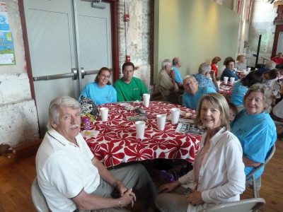
Bobbie Jo Shryock, John Shryock, Douglas Dinkins, Rebecca Dinkins
In front, Jerry Edwards, and Martha Edwards

Slide 19
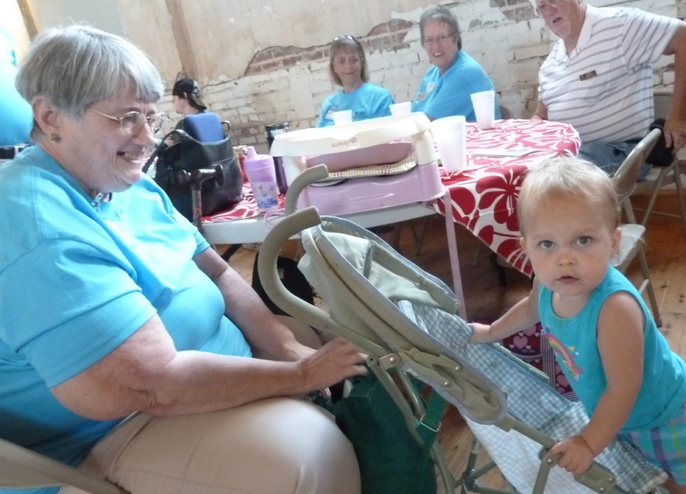
Michelle Alexander, Shirley Beasley, Jerry Beasley
In front, Linda Vawter with granddaughter Lilah

Slide 20
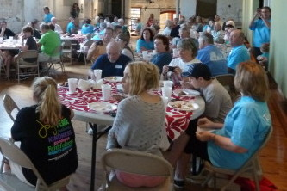
In front, Reba Alexander, Kaitlin Johnston,
Patricia Renton and Luke Williams.

Slide 21
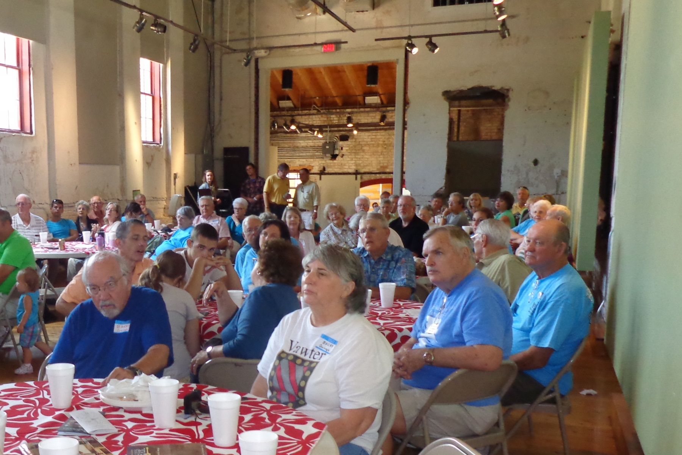
Front table, Barry and Becky Guinagh. Next table on right, Phil Vaughter and Garry Vawter. Joe, Bonita, Darren, Will and Anna Welch

Slide 22
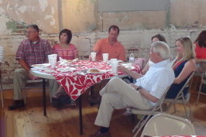
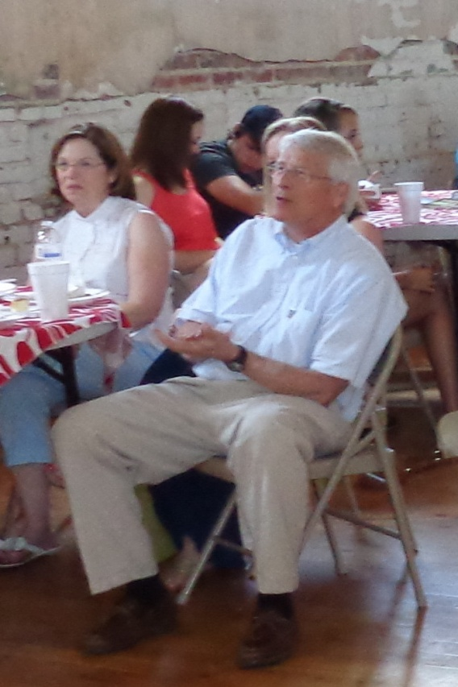
Guests Andy and Nancy Anderson, Kirk Sims, Gayle Wicker,
Caroline Sims. In front Roger Wicker.
Gayle and Roger

Slide 23
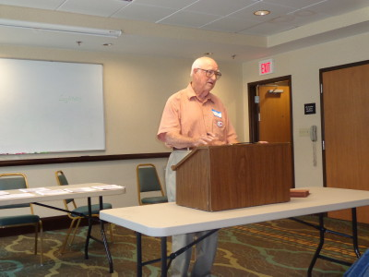
Fred Wicker gave us a genealogy lesson.
We always enjoy his stories.

Slide 24
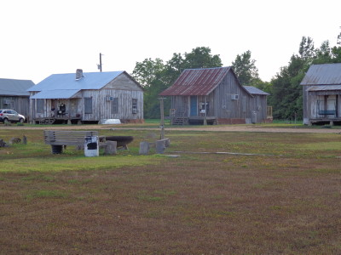
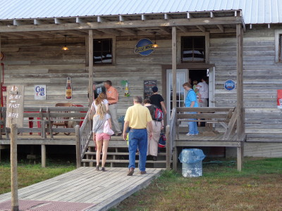
Friday night the cousins gathered
at Tallahatchie Flats for a fish fry
and live music by recording artist
Steve Azar.
Above: the little houses are for
rent for vacations. They are clean
but not “modern”.

Slide 25
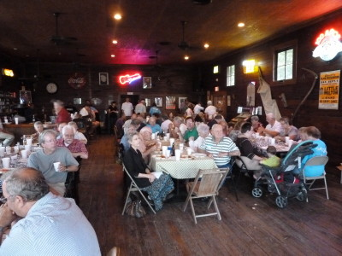
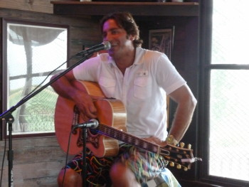
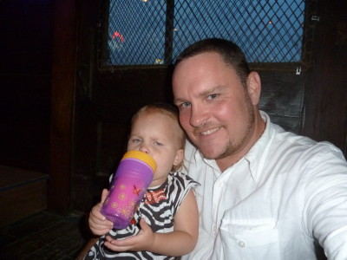
After a tasty meal of catfish and the trimmings, Steve Azar sang for us.
Looks like our adopted cousin,
Miles Russell , has a new friend.
Miles is the Northern Region Field Rep. and was a big help with the reunion.

Slide 26
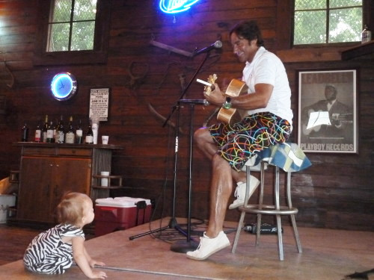
Steve Azar and one of his many fans.

Slide 27
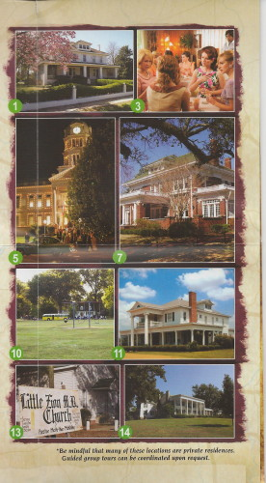
VVV cousins enjoyed the tour of the many locations
used in the filming of the movie “The Help”

Slide 28
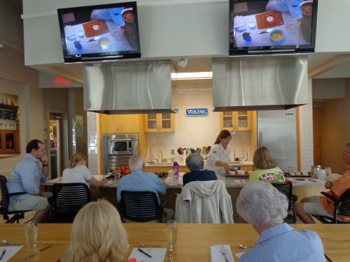
The Viking Range cooking demonstration was enjoyable and the meal was outstanding. Chef Elizabeth Heiskell was very entertaining and informative.

Slide 29
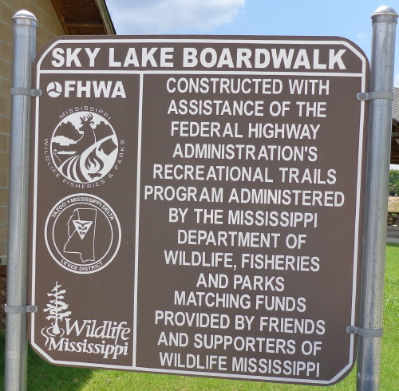
One of the “optional activities” was the Sky Lake Cypress Park

Slide 30
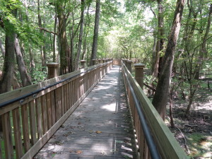
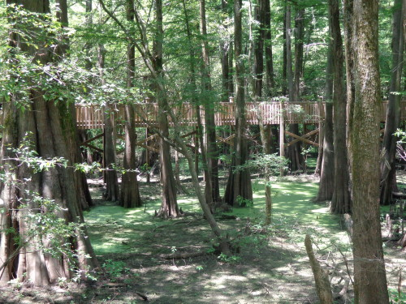

Slide 31
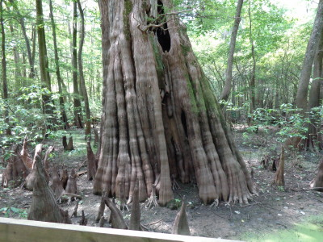

Slide 32
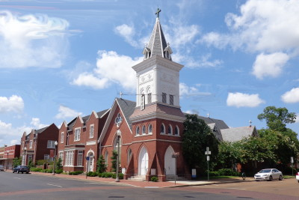
The VVV Association Annual Banquet
was held at the Episcopal Church of the Nativity
in Greenwood, Mississippi

Slide 33
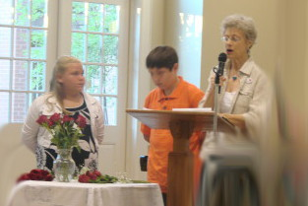
Reba Alexander and Luke Williams assisted Ellen Wicker
with the Memorial Service.

Slide 34
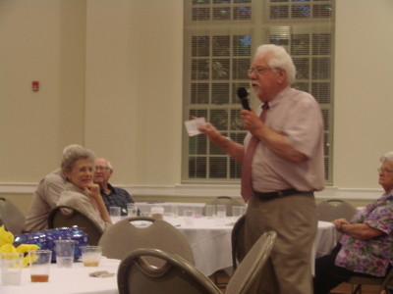
Ken Wicker handled the auction.

Slide 35
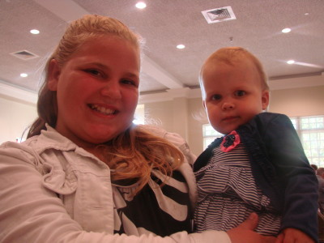
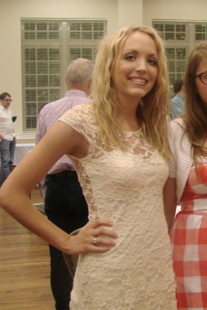
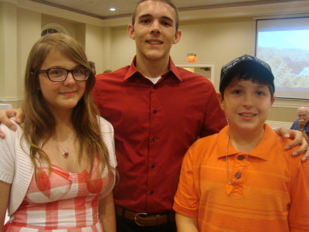
Some of the young people
at the banquet.

Slide 36
A big “THANK YOU” to Gayle and Roger Wicker
for a wonderful reunion. We all know it doesn’t
just happen without a lot of work.
Some of the photos were taken by Miles Russell.
Thank you very much, Miles, and for all the other
things you did “above and beyond the call of duty.”
Kaitlin Johnston also shared photos.
Thank you sweet girl.

